Slide 1
Operating System Principle Chapter 1: Introduction
Feb, 2024

Slide 2
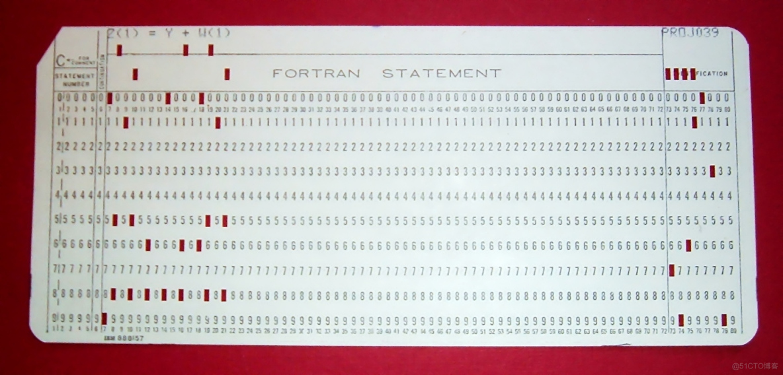
Punch Card
Notes:
上世纪60年代末或70年代初，Arnold Reinold拍摄的FORTRAN计算程序穿孔卡照片

Slide 3

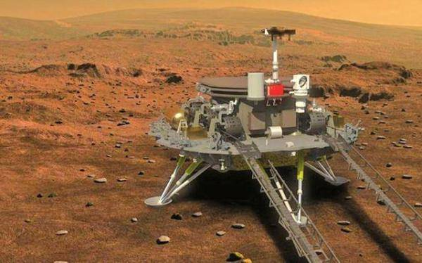
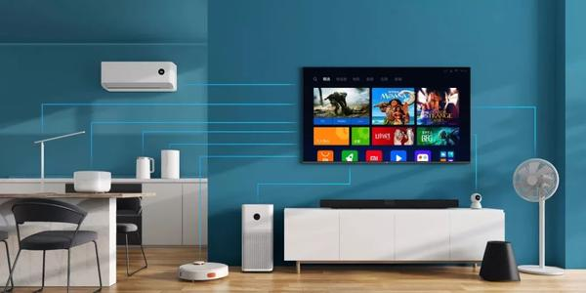
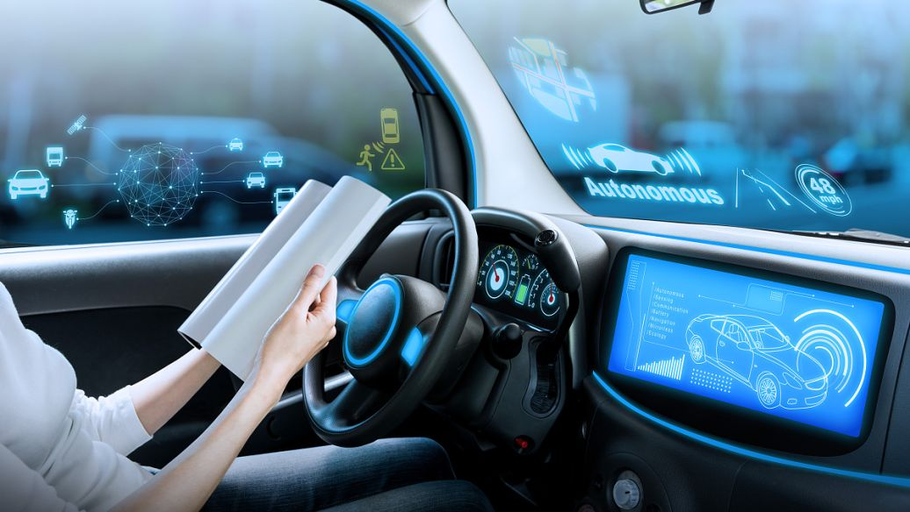
Modern Operating Systems

Slide 4
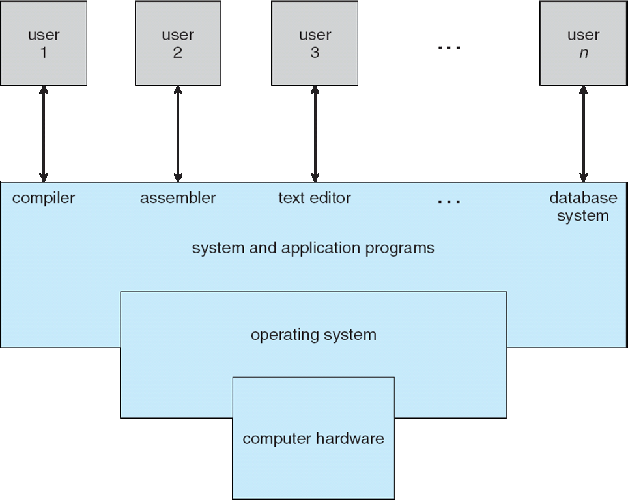
Four Components of a Computer System

Slide 5
Four Components of a Computer System
Computer system can be divided into four components:
Hardware – provides basic computing resources
CPU, memory, I/O devices
Operating system
Controls and coordinates use of hardware among various applications and users
Application programs – define the ways in which the system resources are used to solve the computing problems of the users
Word processors, compilers, web browsers, database systems, video games
Users
People, machines, other computers

Slide 6
What is an Operating System?
An operating system is a program that manages a computer’s hardware.
It also provides a basis for application programs and
Acts as an intermediary between the computer user and the computer hardware.

Slide 7
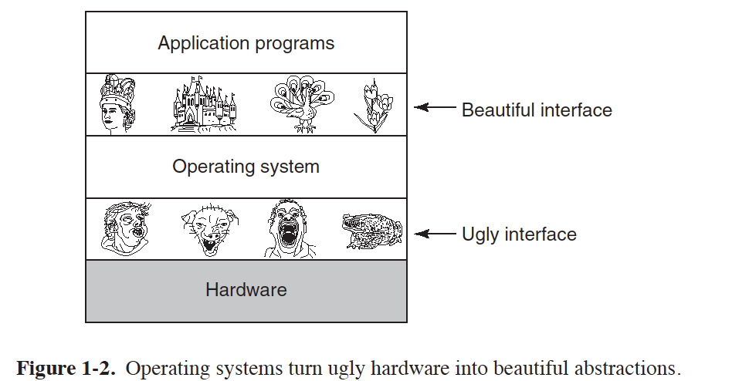
From A User’s View
Users want convenience, ease of use and good performance
Notes:
便捷性

Slide 8
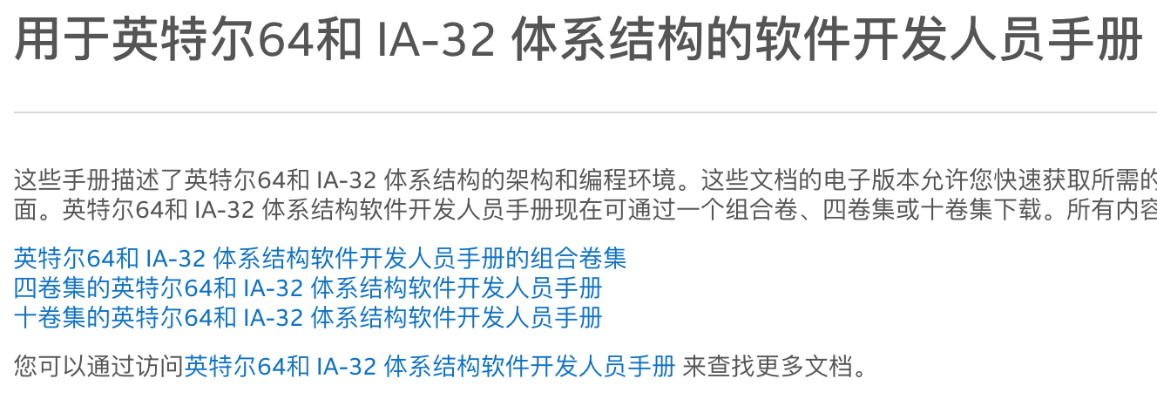
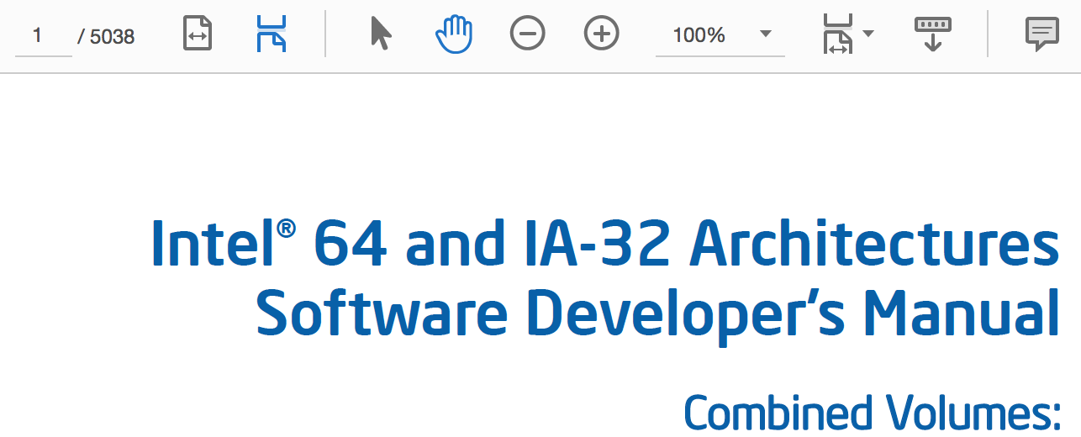
Intel Software Developer’s Manual
Notes:
便捷性

Slide 9
Intel Software Developer’s Manual
Notes:
便捷性

Slide 10
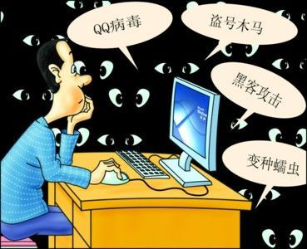
Security View
OS is a control program
Controls execution of programs to prevent errors and improper use of the computer
Notes:
安全性

Slide 11
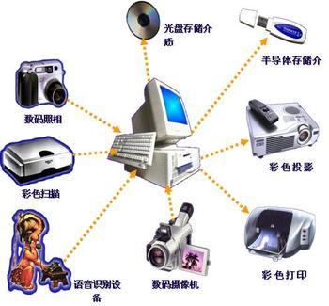
Resource View
OS is a resource allocator
Manages all resources
Decides between conflicting requests for efficient and fair resource use
Notes:
公平性、高效性

Slide 12
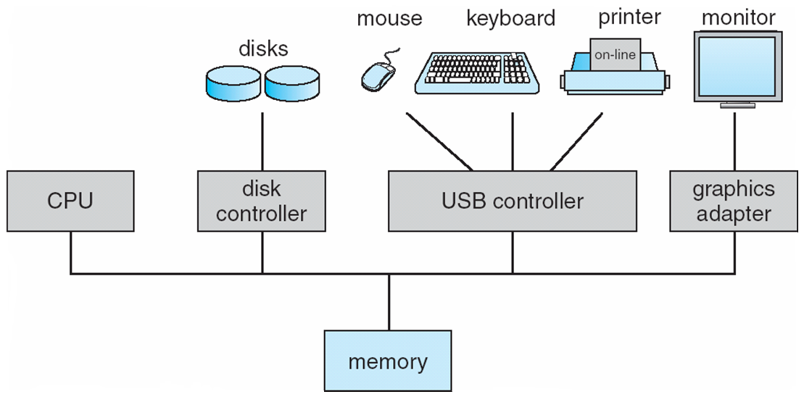
Computer System Organization
Computer-system operation
One or more CPUs, device controllers connect through common bus providing access to shared memory
Concurrent execution of CPUs and devices competing for memory cycles
Notes:
organization.mp4
https://www.jianshu.com/p/defc60406dc1

Slide 13
Computer System Organization
CPU
Register file
ALU
PC
System bus
Memory bus
Main
memory
Bus interface
I/O
bridge
I/O bus
Expansion slots for
other devices such
as network adapters
USB
controller
Graphics
adapter
Disk
controller
Mouse
Keyboard
Display
Disk

Slide 14
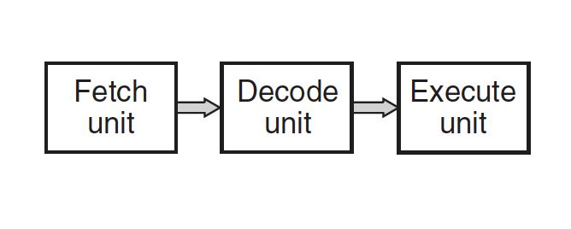
CPU
CPU chip
PC
Register file
ALU
Cache
memories
System bus
Memory bus
Main
memory
Bus interface
I/O
bridge
CPU： 2.70 GHz

Slide 15
Pipeline

Slide 16
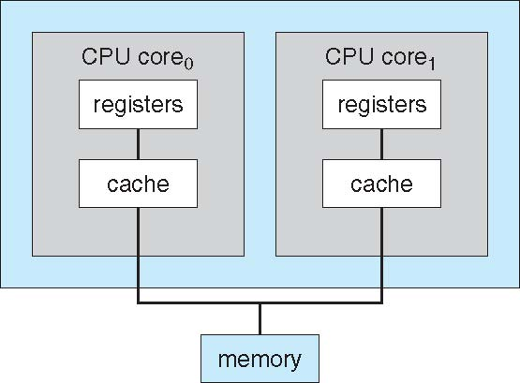
Multicore

Slide 17
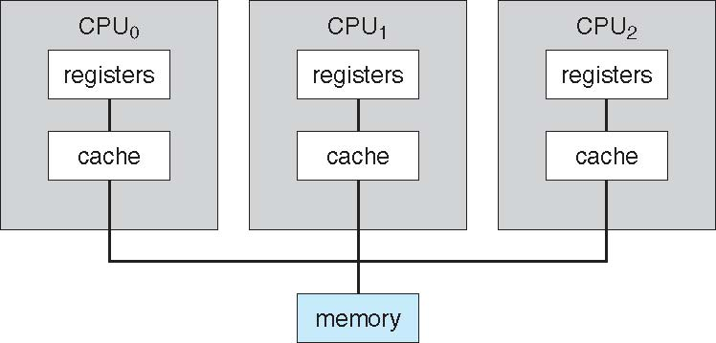
Multiprocessor

Slide 18
Storage Structure
Main memory – only large storage media that the CPU can access directly
Random access
Typically volatile
Secondary storage – extension of main memory that provides large nonvolatile storage capacity
Hard disks – rigid metal or glass platters covered with magnetic recording material
Disk surface is logically divided into tracks, which are subdivided into sectors
The disk controller determines the logical interaction between the device and the computer
Solid-state disks – faster than hard disks, nonvolatile
Various technologies
Becoming more popular

Slide 19
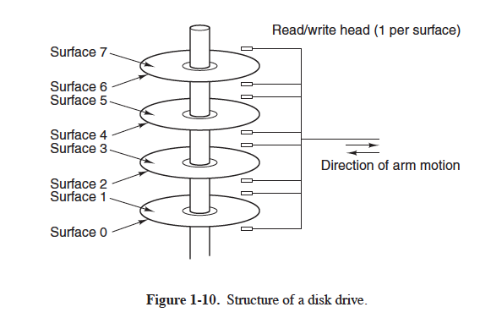
Hard Disk

Slide 20
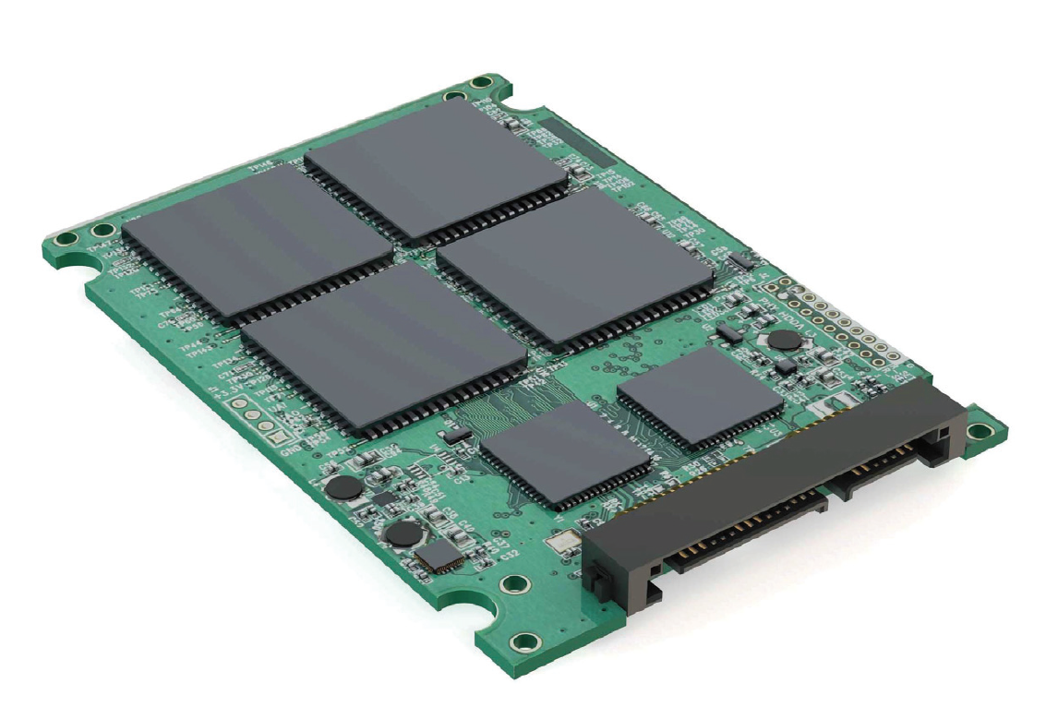
SSD

Slide 21
Storage Definitions and Notation Review
The basic unit of computer storage is the bit.
A byte is 8 bits, and on most computers it is the smallest convenient chunk of storage.
A less common term is word, which is a given computer architecture’s native unit of data. A computer executes many operations in its native word size rather than a byte at a time.
Computer storage, along with most computer throughput, is generally measured and manipulated in bytes and collections of bytes.
A kilobyte, or KB, is 1,024 bytes
a megabyte, or MB, is 1,024² bytes
a gigabyte, or GB, is 1,024³ bytes
a terabyte, or TB, is 1,024⁴ bytes
a petabyte, or PB, is 1,024⁵ bytes
Notes:
https://www.cnblogs.com/yilang/p/11103061.html
在这一页增加：内存编址、地址的三种进制表示及相互转换、地址线与内存大小之间的关系

Slide 22
Memory Addressing
1 bit
1 | 0 | 0 | 1 | 1 | 0 | 0 | 0
1 | 1 | 0 | 1 | 1 | 0 | 0 | 1
0 | 0 | 0 | 1 | 1 | 0 | 1 | 0
. | . | . | . | . | . | . | .
. | . | . | . | . | . | . | .
. | . | . | . | . | . | . | .
. | . | . | . | . | . | . | .
. | . | . | . | . | . | . | .
. | . | . | . | . | . | . | .
. | . | . | . | . | . | . | .
. | . | . | . | . | . | . | .
. | . | . | . | . | . | . | .
0 | 1 | 0 | 0 | 1 | 0 | 1 | 0
1 byte = 1 B
Memory

Slide 23
Memory Addressing
0000
1 | 0 | 0 | 1 | 1 | 0 | 0 | 0
1 | 1 | 0 | 1 | 1 | 0 | 0 | 1
0 | 0 | 0 | 1 | 1 | 0 | 1 | 0
. | . | . | . | . | . | . | .
. | . | . | . | . | . | . | .
. | . | . | . | . | . | . | .
. | . | . | . | . | . | . | .
. | . | . | . | . | . | . | .
. | . | . | . | . | . | . | .
. | . | . | . | . | . | . | .
. | . | . | . | . | . | . | .
. | . | . | . | . | . | . | .
0 | 1 | 0 | 0 | 1 | 0 | 1 | 0
0
0
0
0
Address bus
Memory

Slide 24
Memory Addressing
1 | 0 | 0 | 1 | 1 | 0 | 0 | 0
1 | 1 | 0 | 1 | 1 | 0 | 0 | 1
0 | 0 | 0 | 1 | 1 | 0 | 1 | 0
. | . | . | . | . | . | . | .
. | . | . | . | . | . | . | .
. | . | . | . | . | . | . | .
. | . | . | . | . | . | . | .
. | . | . | . | . | . | . | .
. | . | . | . | . | . | . | .
. | . | . | . | . | . | . | .
. | . | . | . | . | . | . | .
. | . | . | . | . | . | . | .
0 | 1 | 0 | 0 | 1 | 0 | 1 | 0
0010
0
0
1
0
Address bus
Memory

Slide 25
Memory Addressing
1 | 0 | 0 | 1 | 1 | 0 | 0 | 0
1 | 1 | 0 | 1 | 1 | 0 | 0 | 1
0 | 0 | 0 | 1 | 1 | 0 | 1 | 0
. | . | . | . | . | . | . | .
. | . | . | . | . | . | . | .
. | . | . | . | . | . | . | .
. | . | . | . | . | . | . | .
. | . | . | . | . | . | . | .
. | . | . | . | . | . | . | .
. | . | . | . | . | . | . | .
. | . | . | . | . | . | . | .
. | . | . | . | . | . | . | .
0 | 1 | 0 | 0 | 1 | 0 | 1 | 0
0001
11011001
1
1
0
0
1
1
0
0
0
0
1
1
Address bus
Data bus
Memory

Slide 26
Binary vs Hexadecimal
1 | 0 | 0 | 1 | 1 | 0 | 0 | 0
1 | 1 | 0 | 1 | 1 | 0 | 0 | 1
0 | 0 | 0 | 1 | 1 | 0 | 1 | 0
. | . | . | . | . | . | . | .
. | . | . | . | . | . | . | .
. | . | . | . | . | . | . | .
. | . | . | . | . | . | . | .
. | . | . | . | . | . | . | .
. | . | . | . | . | . | . | .
. | . | . | . | . | . | . | .
. | . | . | . | . | . | . | .
. | . | . | . | . | . | . | .
1 | 0 | 1 | 1 | 0 | 1 | 0 | 1
0 | 1 | 0 | 0 | 1 | 0 | 1 | 0
Address bus
1
1
0
0
Memory
0xC/CH
1100

Slide 27
Storage Hierarchy
Storage systems organized in hierarchy
Speed
Cost
Volatility

Slide 28
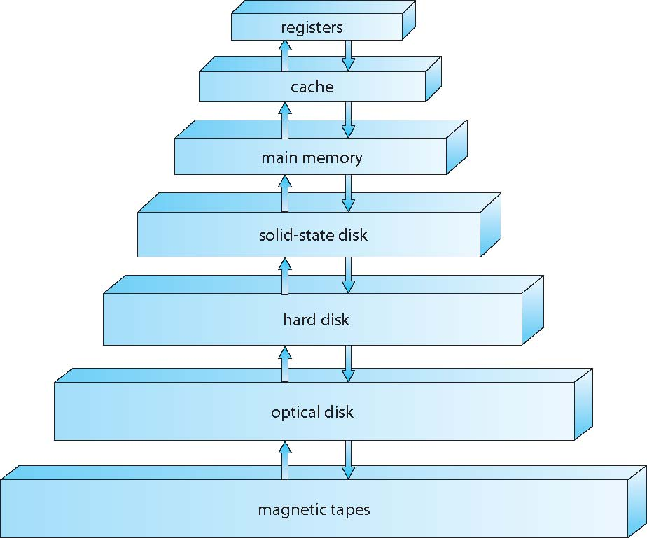
Storage-Device Hierarchy

Slide 29
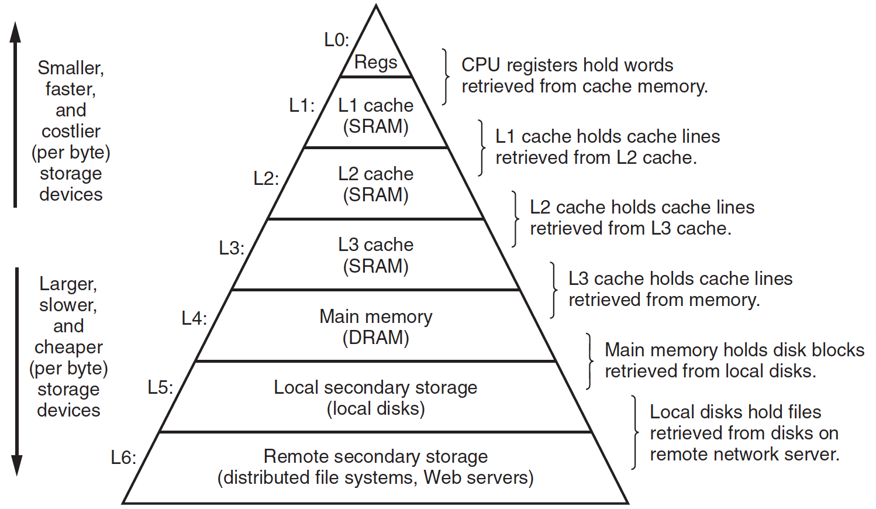
Storage-Device Hierarchy

Slide 30
Caching
Important principle, performed at many levels in a computer (in hardware, operating system, software)
Information in use copied from slower to faster storage temporarily
Faster storage (cache) checked first to determine if information is there
If it is, information used directly from the cache (fast)
If not, data copied to cache and used there
Cache smaller than storage being cached
Cache replacement policy

Slide 31
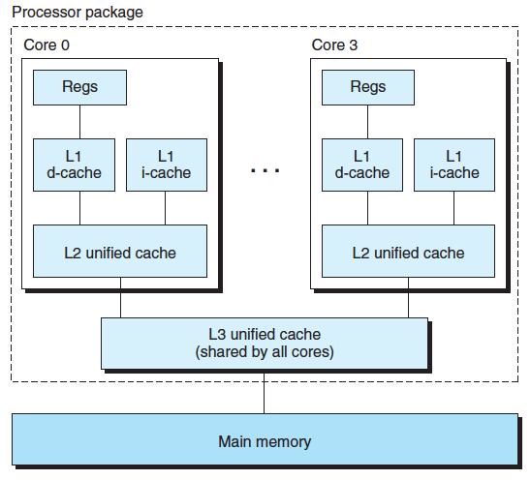
Three Levels of Cache on Multicore
Notes:
地球赤道的周长

Slide 32
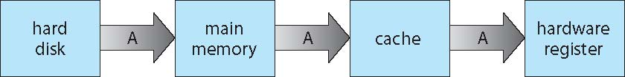
Migration of data ‘A’
Multitasking environments must be careful to use most recent value, no matter where it is stored in the storage hierarchy
Multiprocessor environment must provide cache coherency in hardware such that all CPUs have the most recent value in their cache

Slide 33
I/O Device
Devices
Device controller/adapter
Device Driver for each device controller to manage I/O
Provides uniform interface between controller and kernel

Slide 34
Write
CPU
Register file
ALU
PC
System bus
Memory bus
hello code
Main
memory
"hello,world\n"
Bus interface
I/O
bridge
I/O bus
Expansion slots for
other devices such
as network adapters
USB
controller
Graphics
adapter
Disk
controller
Mouse
Keyboard
Display
Disk
hello executable
stored on disk
"hello,world\n"
Notes:
寄存器堆

Slide 35
Read
CPU
Register file
ALU
PC
System bus
Memory bus
Main
memory
"hello"
Bus interface
I/O
bridge
I/O bus
Expansion slots for
other devices such
as network adapters
USB
controller
Graphics
adapter
Disk
controller
Mouse
Keyboard
Display
Disk
User types
"hello"

Slide 36
Direct Memory Access Structure
CPU
Register file
ALU
PC
System bus
Memory bus
hello code
Main
memory
"hello,world\n"
Bus interface
I/O
bridge
I/O bus
Expansion slots for
other devices such
as network adapters
USB
controller
Graphics
adapter
Disk
controller
Mouse
Keyboard
Display
Disk
hello executable
stored on disk

Slide 37
Think About
What happens when the computer has no task to do?
demo
What is the first action you take to operate a computer to perform a certain task, e.g. to play a video?
Notes:
Taskmgr: idle process

Slide 38
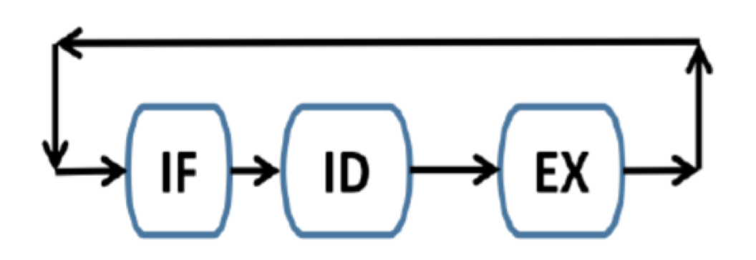
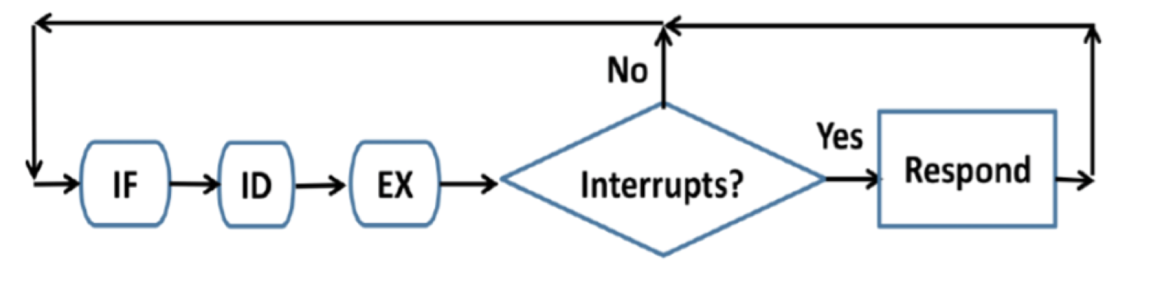
Interrupt

Slide 39
Interrupt driven
Interrupt driven (hardware and software)
Hardware interrupt by one of the devices
Software interrupt (exception or trap):
Software error (e.g., division by zero)
Request for operating system service
Other process problems include infinite loop, processes modifying each other or the operating system

Slide 40
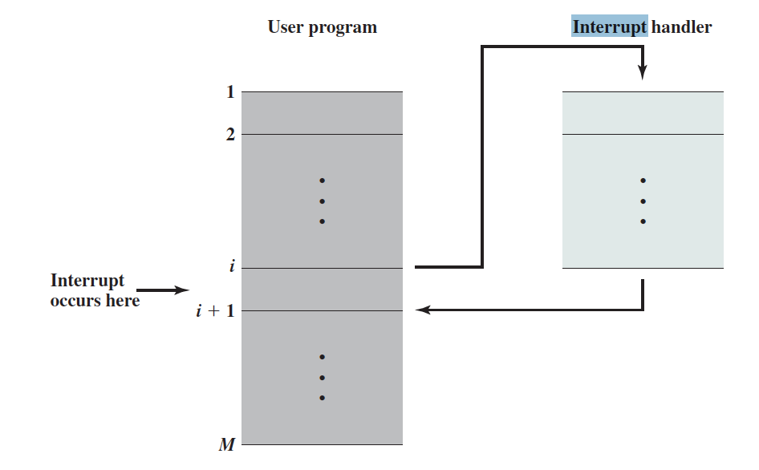
Interrupt Processing

Slide 41
Interrupt Vector
Interrupt vector table
Interrupt descriptor table
Interrupt service routine

Slide 42
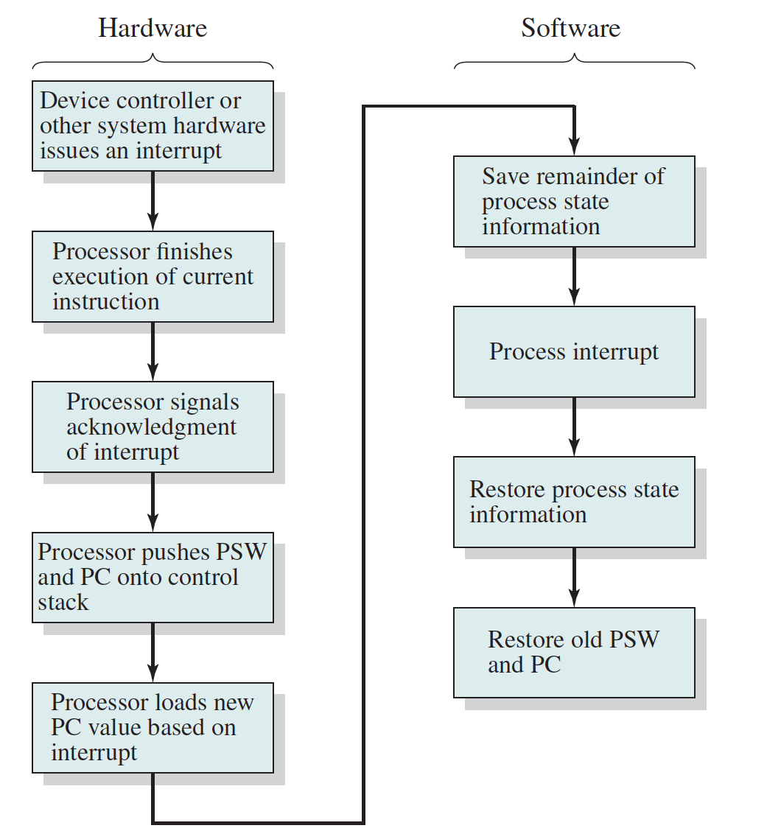
Context Save
Notes:
pc, sp, psw【此处在进程上下文中可以重点讲一下】

Slide 43
Functionality of OS

Slide 44
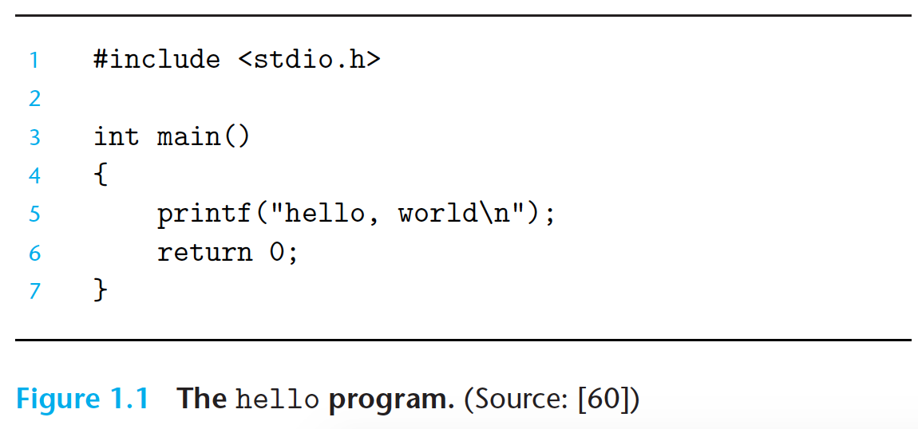
Hello World
Notes:
使用helloworld编写、存储、编译、运行的例子展示操作系统的几大功能

Slide 45
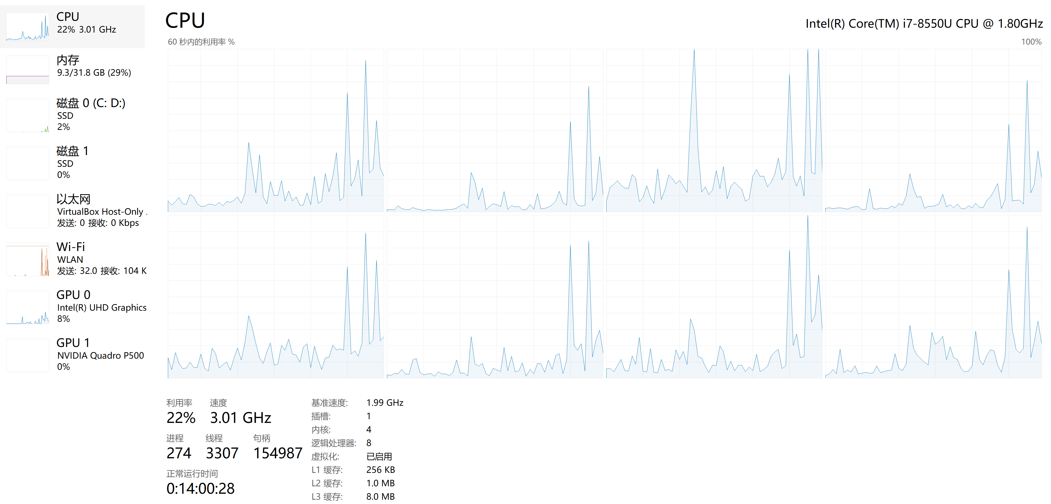
Functionality of OS
Windows 11
Demonstration
Notes:
文件树
设备管理器

Slide 46
Process Management
A process is a program in execution. It is a unit of work within the system. Program is a passive entity, process is an active entity.
Process needs resources to accomplish its task
CPU, memory, I/O, files
Initialization data
Process termination requires reclaim of any reusable resources
Single-threaded process has one program counter specifying location of next instruction to execute
Process executes instructions sequentially, one at a time, until completion
Multi-threaded process has one program counter per thread
Typically system has many processes, some user, some operating system running concurrently on one or more CPUs
Concurrency by multiplexing the CPUs among the processes / threads

Slide 47
Process Management Activities
The operating system is responsible for the following activities in connection with process management:
Creating and deleting both user and system processes
Suspending(挂起) and resuming（重启） processes
Providing mechanisms for process synchronization
Providing mechanisms for process communication
Providing mechanisms for deadlock handling

Slide 48
Memory Management
To execute a program all (or part) of the instructions must be in memory
All (or part) of the data that is needed by the program must be in memory.
Memory management determines what is in memory and when
Optimizing CPU utilization and computer response to users
Memory management activities
Keeping track of which parts of memory are currently being used and by whom
Deciding which processes (or parts thereof) and data to move into and out of memory
Allocating and deallocating memory space as needed

Slide 49
Storage Management
OS provides uniform, logical view of information storage
Abstracts physical properties to logical storage unit - file
Each medium is controlled by device (i.e., disk drive, tape drive)
Varying properties include access speed, capacity, data-transfer rate, access method (sequential or random)
File-System management
Files usually organized into directories
Access control on most systems to determine who can access what
OS activities include
Creating and deleting files and directories
Primitives to manipulate files and directories
Mapping files onto secondary storage
Backup files onto stable (non-volatile) storage media

Slide 50
Mass-Storage Management
Usually disks used to store data that does not fit in main memory or data that must be kept for a “long” period of time
Proper management is of central importance
Entire speed of computer operation hinges on disk subsystem and its algorithms
OS activities
Free-space management
Storage allocation
Disk scheduling
Some storage need not be fast
Tertiary storage includes optical storage, magnetic tape
Still must be managed – by OS or applications
Varies between WORM (write-once, read-many-times) and RW (read-write)

Slide 51
I/O Subsystem
One purpose of OS is to hide peculiarities of hardware devices from the user
I/O subsystem responsible for
Memory management of I/O including buffering (storing data temporarily while it is being transferred), caching (storing parts of data in faster storage for performance), spooling (the overlapping of output of one job with input of other jobs)
General device-driver interface
Drivers for specific hardware devices

Slide 52
Contents
Chapter 1
Chapter 2
Chapter 3
Chapter 4
Chapter 5
Chapter 6
Chapter 7
Chapter 8
Chapter 9
Chapter 10
Chapter 11
Chapter 12
Chapter 13

Slide 53

During This Course

Slide 54

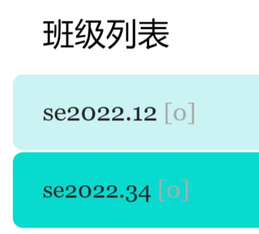
Homework
https://www.scholat.com/course/os2024swu
班级：
申请加入时请提供完整学号和姓名！

Slide 55
End of Chapter 1
Questions?

